Slide 1
Spark : Cluster Computing with Working Sets HotCloud `10
CMS Lab
WooYeon Lee

Slide 2
RoadMap
Introduction
Spark framework
RDD : Resilient Distributed Dataset
Examples
Evaluations

Slide 3
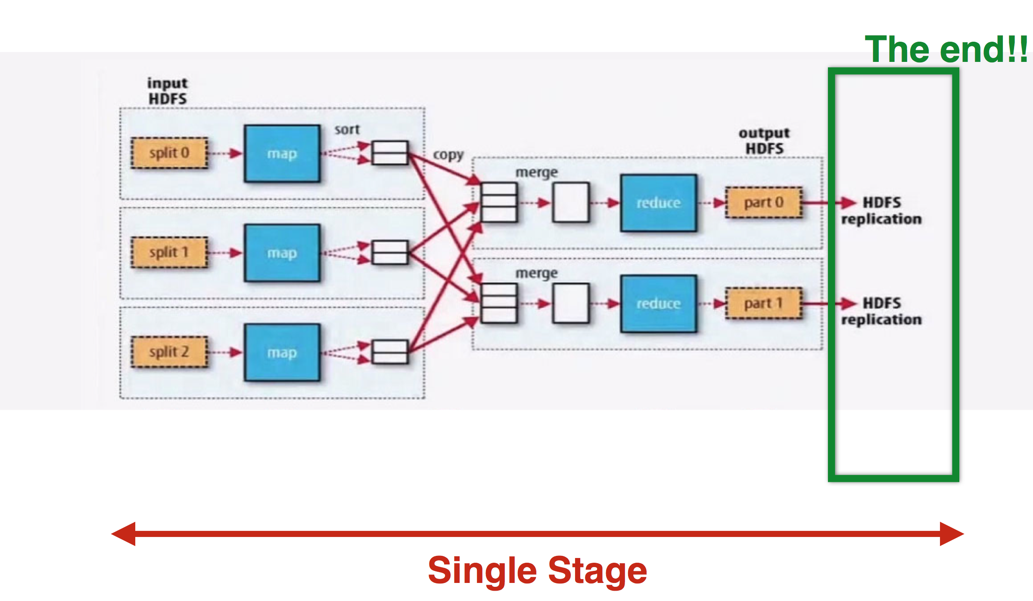
Single-stage, Batch-style Map-reduce jobs
Cluster computing frameworks like MapReduce [10] and Dryad [19] have been widely adopted for large-scale data analytics.
Input acyclic data flow graphs through a set of operators.

Slide 4
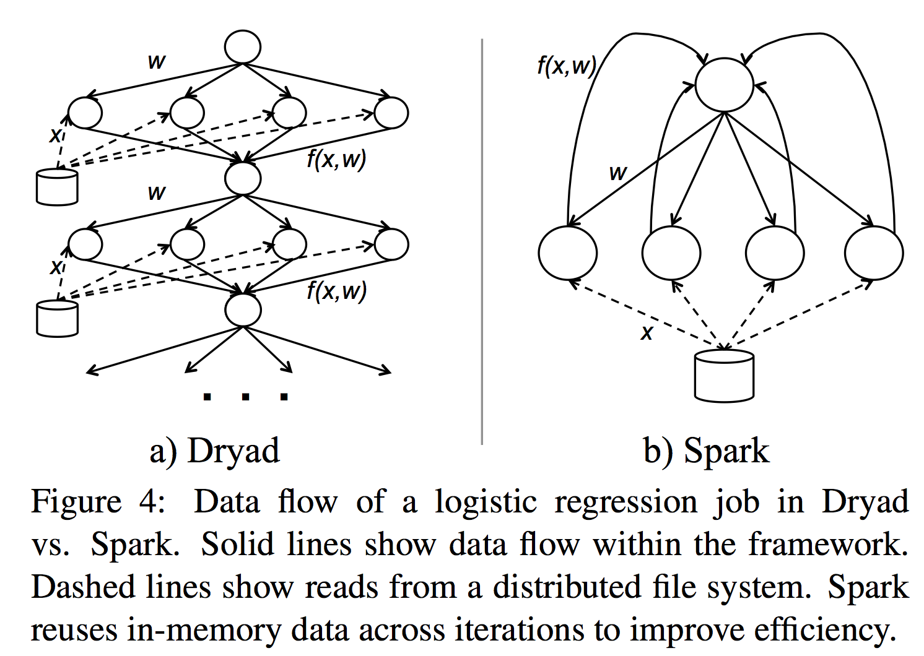
Multi-stage Applications & Ad-hoc Queries
Applications that can not be expressed efficiently as acycle data flows.
Reuse a working set of data
Iterative jobs:
Machine learning algorithm
Graph algorithm
Interactive data mining:
Multiple ad-hoc queries on the same subset of the data

Slide 5
Contributions
Framework which supports applications with working sets while providing similar scalability and fault tolerance properties to MapRecude.
The first system to allow an efficient, general-purpose programming language to be used interactively to process large datasets on a cluster.

Slide 6
Spark : Re-use of working sets

Slide 7
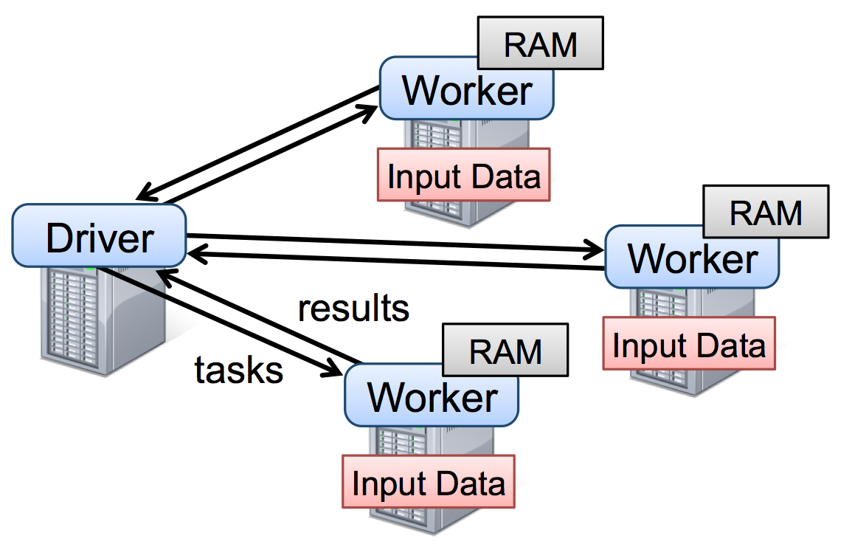
Spark
Main Abstractions
Resilient Distributed Datasets
Parallel Operations
Supports
Shared Variables
Interactive Shell
Notes:
To use Spark, developers write a driver program that implements the high-level control flow of their application and launches various operations in parallel.

Slide 8
RDD : Resilient Distributed Datasets
Distributed memory abstraction
Programmer can perform in-memory computations on large clusters in a fault-tolerant manner
A read-only collection of objects partitioned across a set of machines that can be rebuilt if a partition is lost.
RDD is represented by a scala object.

Slide 9
Parallel Operations
Reduce : combines dataset elements using an associative function to produce a result at the driver program.
Collect : Sends all elements of the dataset to the driver program.
Foreach : Passes each element through a user provided function.

Slide 10
Shared Variables
Broadcast variables:
Large read-only piece of data (e.g., lookup table).
Distribute it to the workers only once instead of packaging it with every closure.
Accumulators:
Workers can only add Only the driver can read.
Can be used to implement counters as in MapReduce and to provide a more imperative syntax for parallel sums.
Notes:
Spark also lets programmers create two restricted types of shared variables to support two simple but common usage patterns

Slide 11
Spark Programming Interface
Implemented in Scala
Scala : A statically typed high-level programming language for the Java VM
Exposes Functional programming interface
Interactive shell : Integrate Scala Interpreter

Slide 12
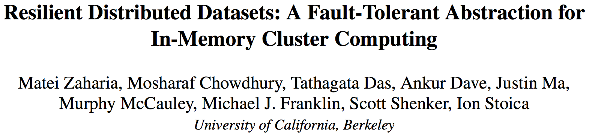
RDD
NSDI `12

Slide 13
Existing Fault Tolerant Solution
Fine-grained updates to mutable states(cells in a table)
Replicate data
Logging change
Expensive for Data-intensive workloads
Require copying large amounts of data over the cluster network
Cluster Network bandwidth <<< RAM bandwidth
=> Storage overhead

Slide 14
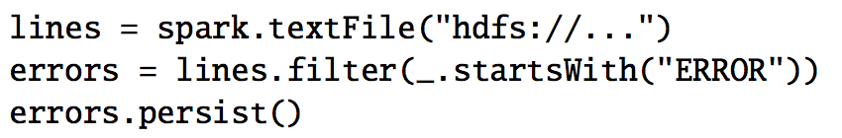
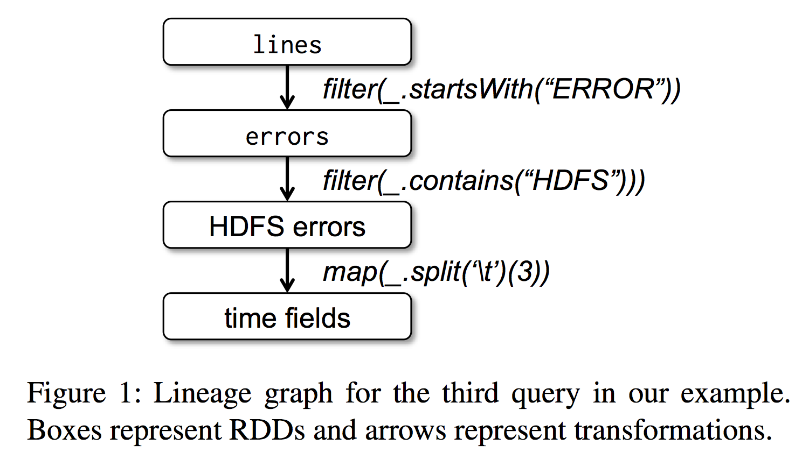
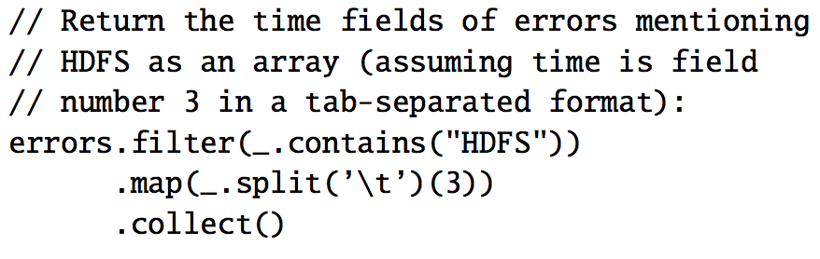
RDD’s Solution for Fault Tolerance
Coarse-grained deterministic transformations
Log transformations rather than the actual data
When partition of an RDD lost, recompute it using information about how it was derived from other RDDs (lineage)

Slide 15
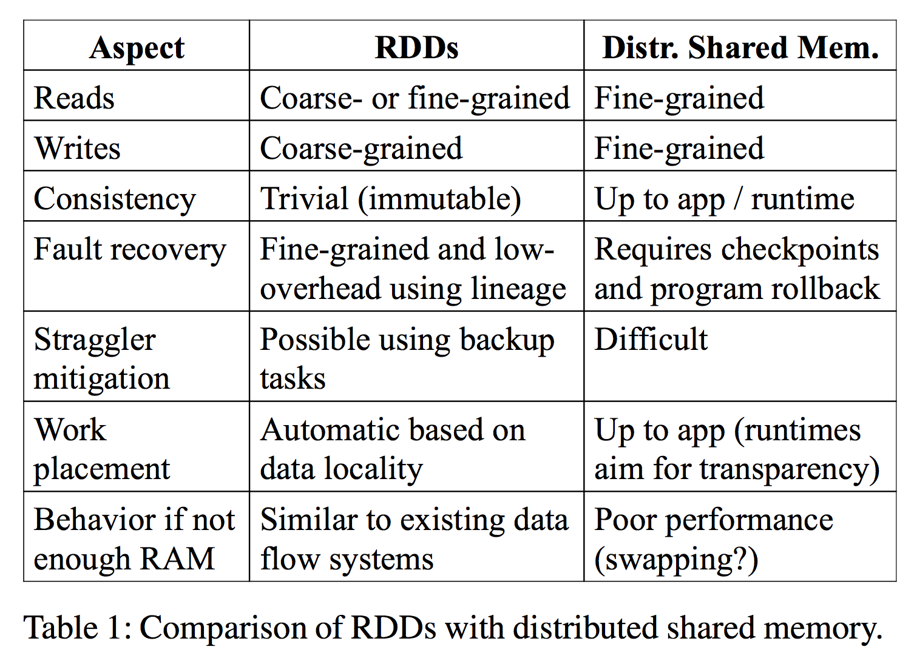
RDD model vs DSM (Distributed Shared Memory)
Notes:
RDDs can only be created through coarse-grained transformation, while DSM allows reads and write to each memory location

Slide 16
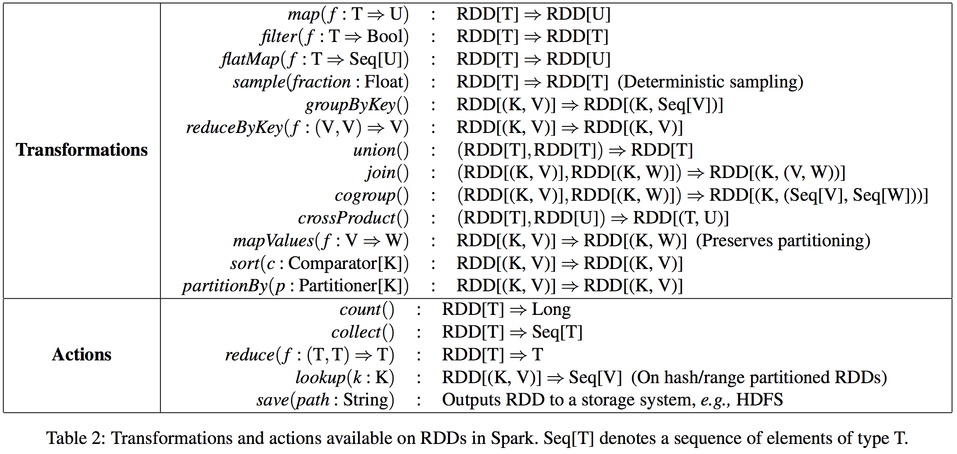
Spark Programming Interface
Define RDDs through transformations
Use RDDs in actions
Notes:
Actions , which are operations that return a value to the application or export data to a storage system.

Slide 17
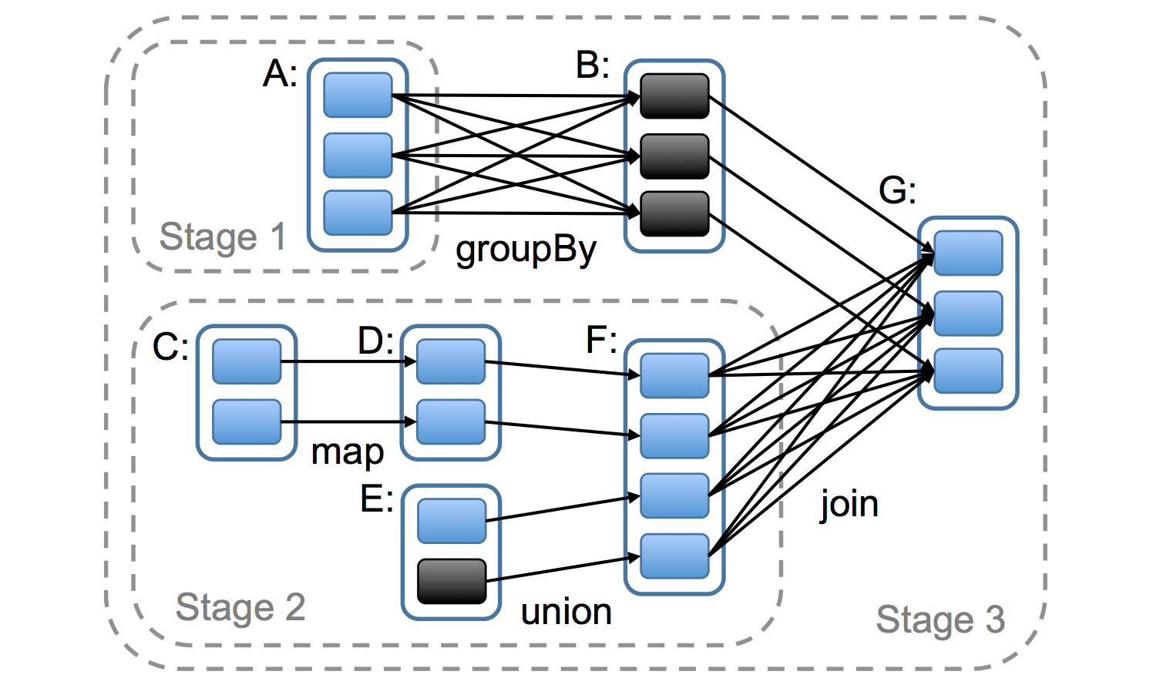
How Spark Computes Job Stages
Notes:
Figure 5: Example of how Spark computes job stages. Boxes with solid outlines are RDDs. Partitions are shaded rectangles, in black if they are already in memory. To run an action on RDD G, we build build stages at wide dependencies and pipeline nar- row transformations inside each stage. In this case, stage 1’s output RDD is already in RAM, so we run stage 2 and then 3.

Slide 18
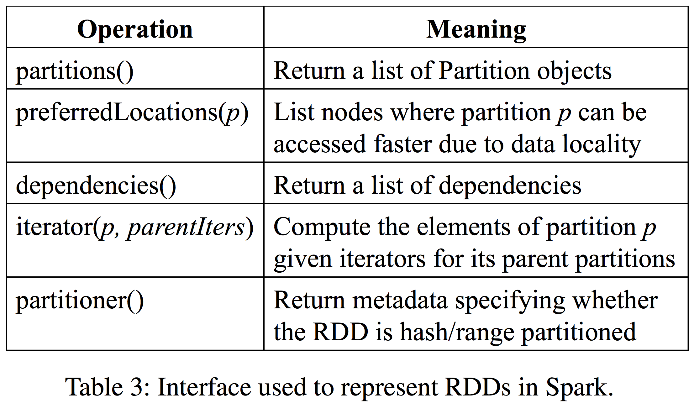
Representing RDDs

Slide 19
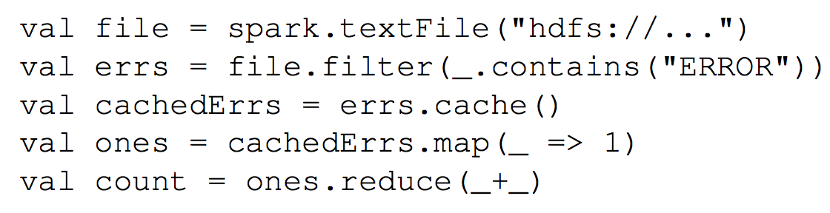
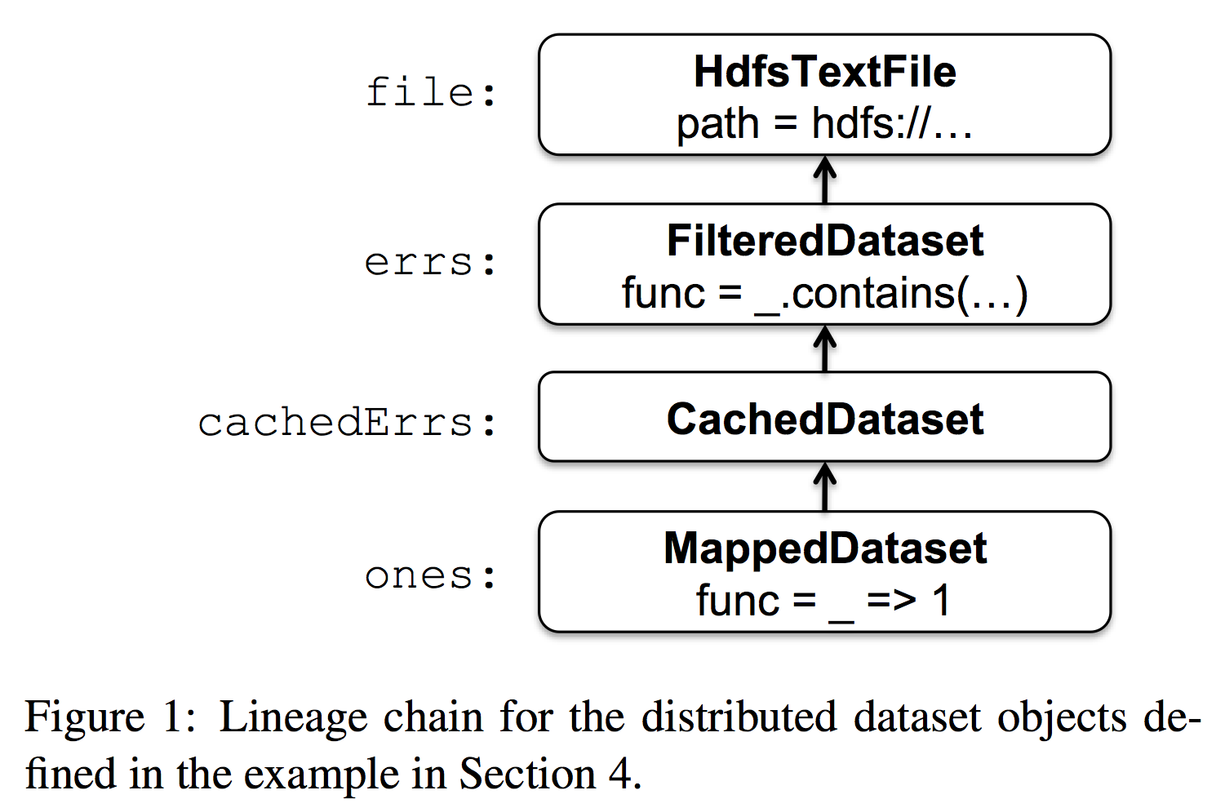
Example: Text Search

Slide 20
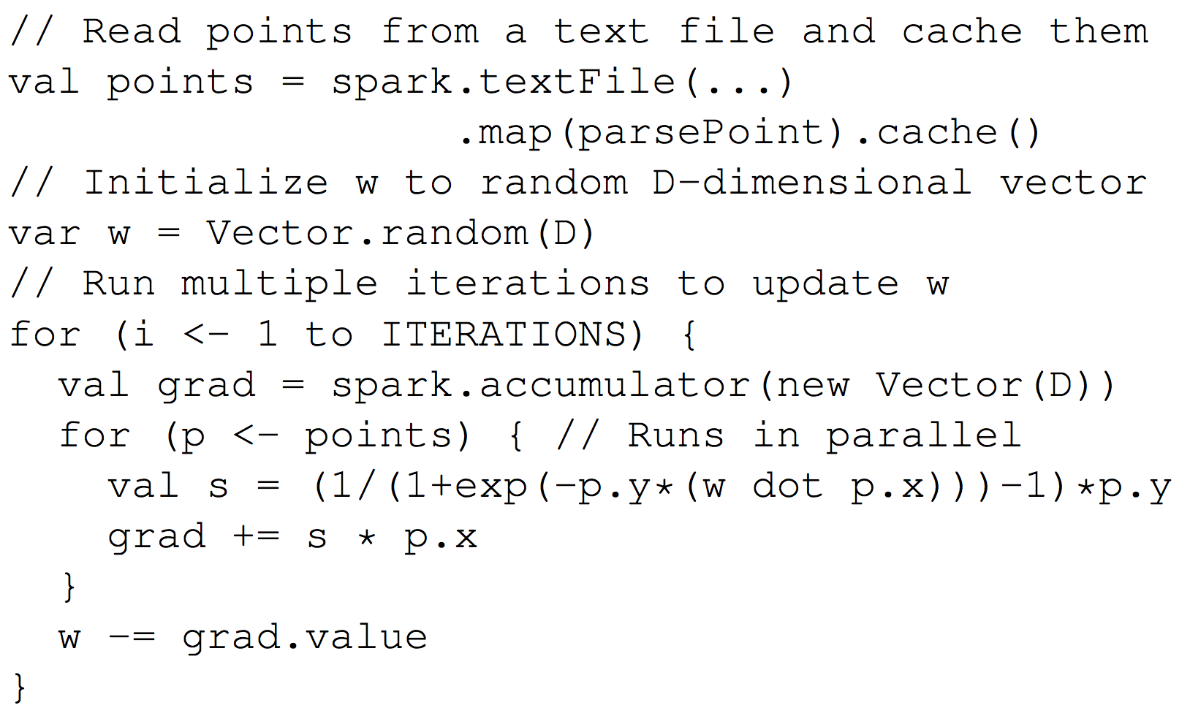
Example: Logistic Regression
Gradient descent
Caching the data in memory across iteration

Slide 21
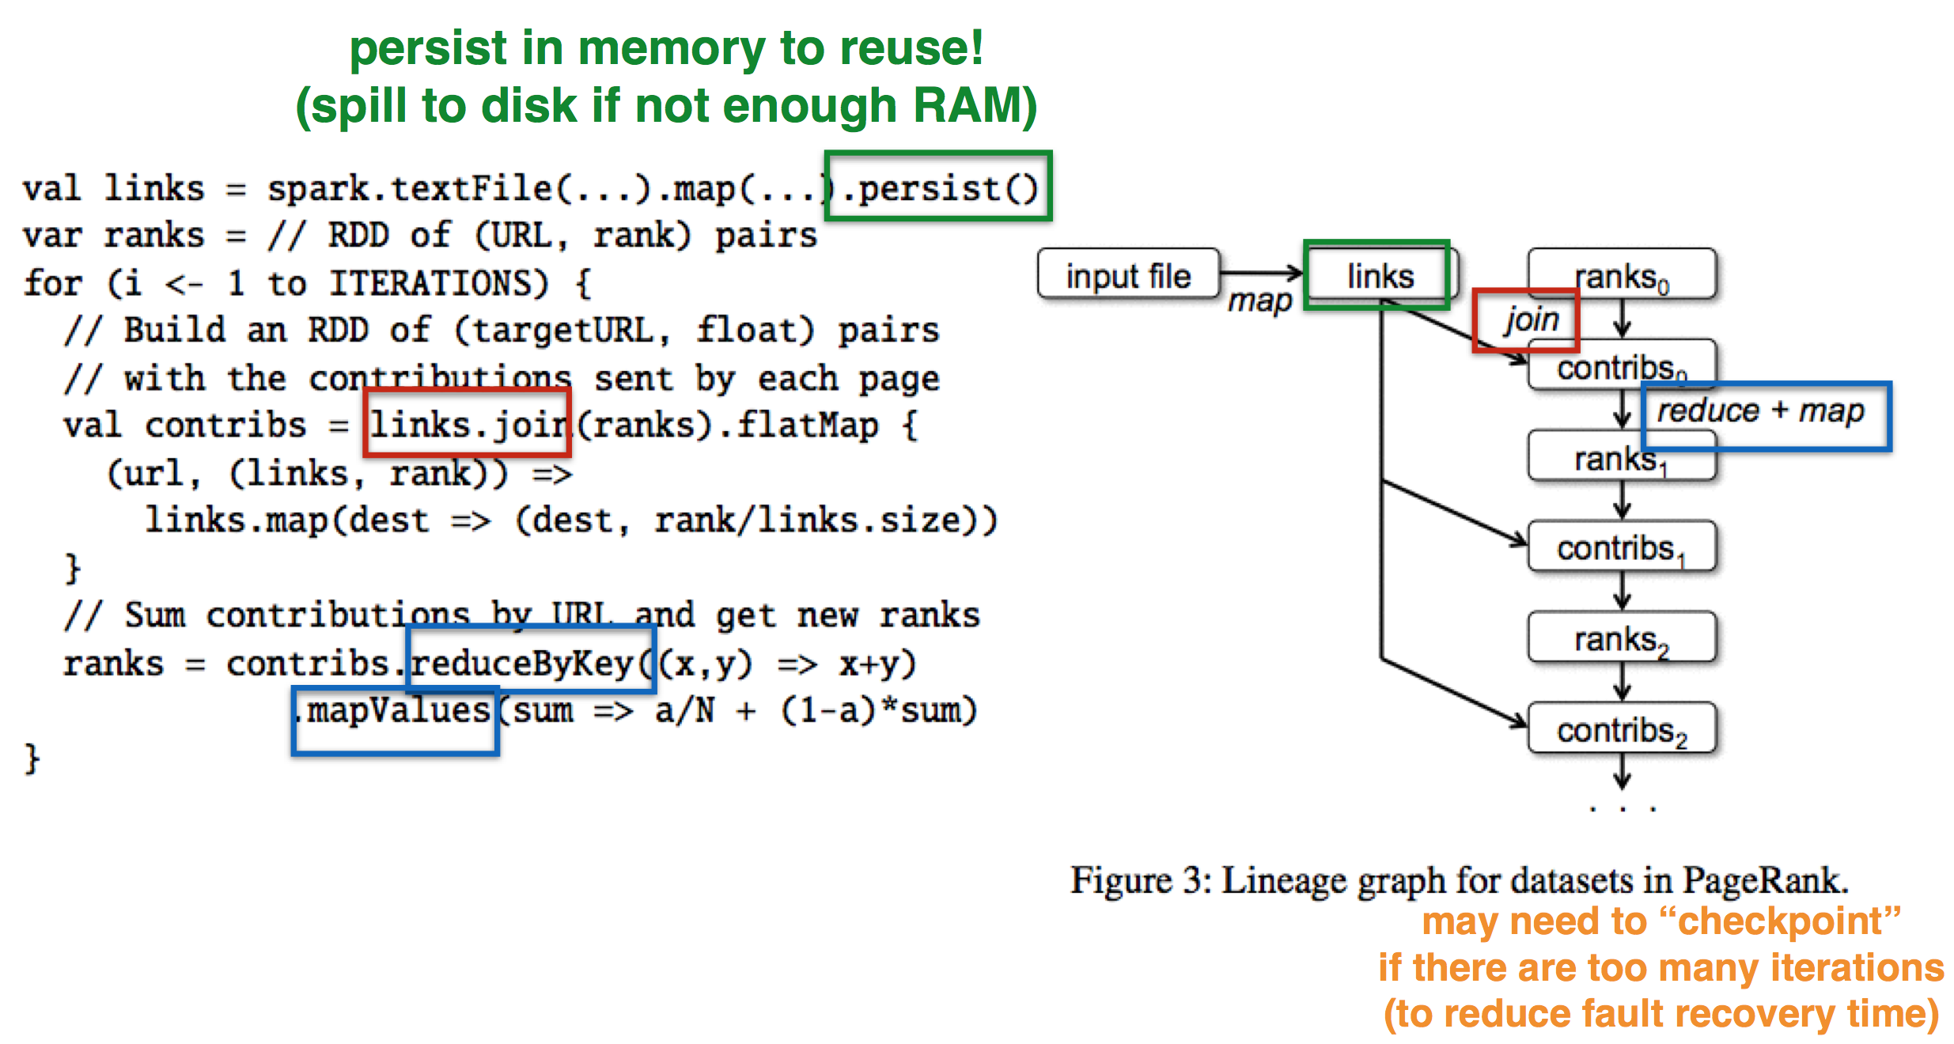
Example: PageRank

Slide 22
Evaluation Environment
Hadoop : 0.20.2 stable release
HadoopBinMem : eliminate text parsing in later interation
10 iterations on 100 GB dataset using 25-100 machines
Notes:
Duration of the first and later iterations in Hadoop, HadoopBinMem and Spark for logistic regression and k-means using 100 GB of data on a 100-node cluster.

Slide 23
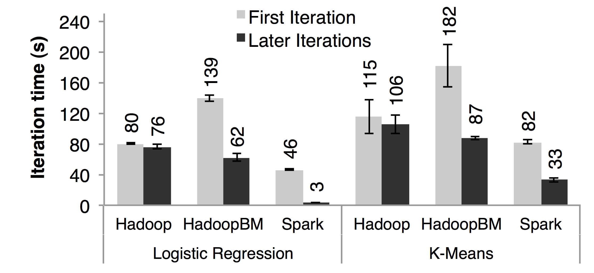
Evaluation : Iterative Machine Learning Algorithm
Notes:
Duration of the first and later iterations in Hadoop, HadoopBinMem and Spark for logistic regression and k-means using 100 GB of data on a 100-node cluster.

Slide 24
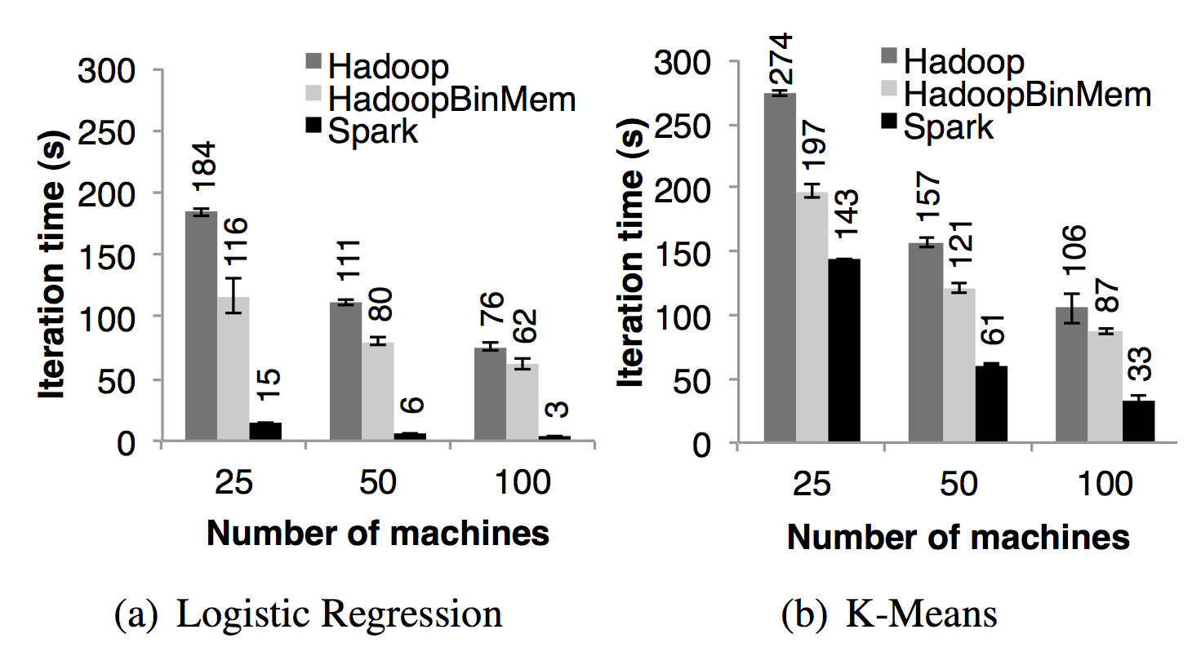
Evaluation : Iterative Machine Learning Algorithm

Slide 25
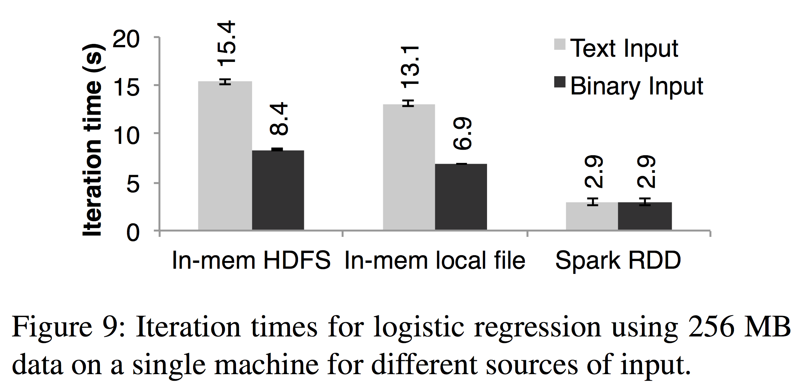
Evaluation : Iterative Machine Learning Algorithm

Slide 26
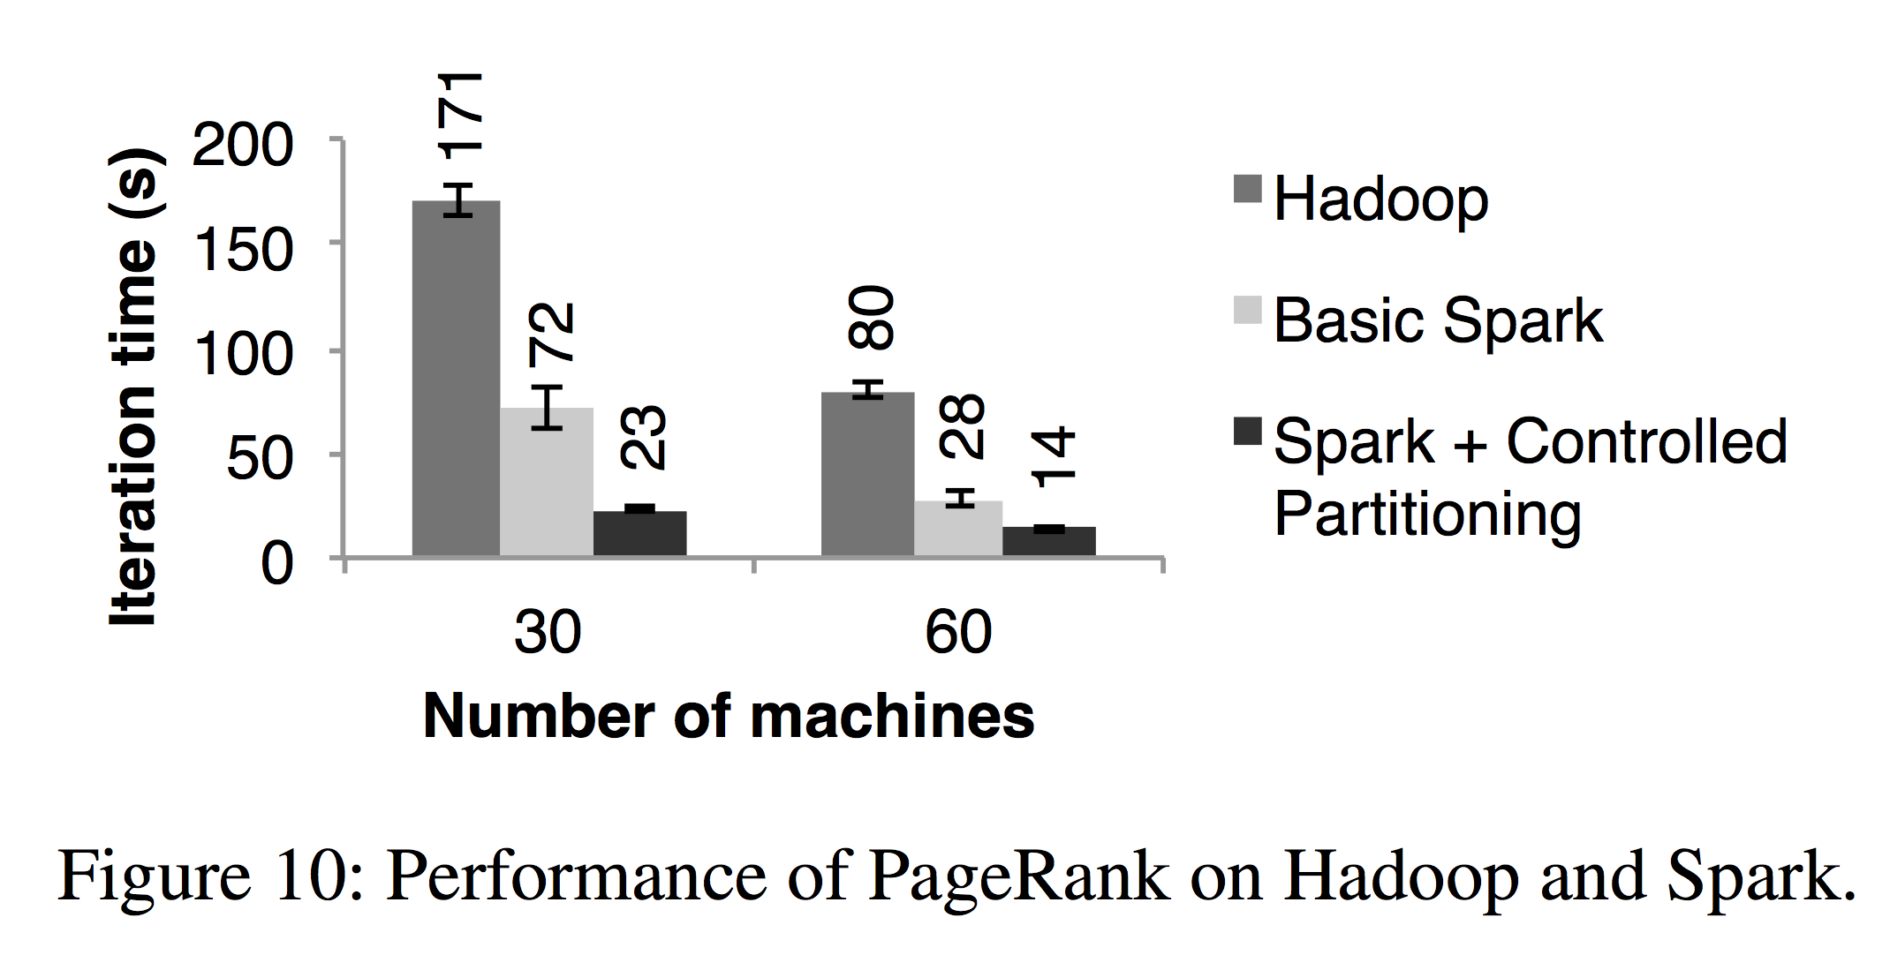
Evaluation : PageRank

Slide 27
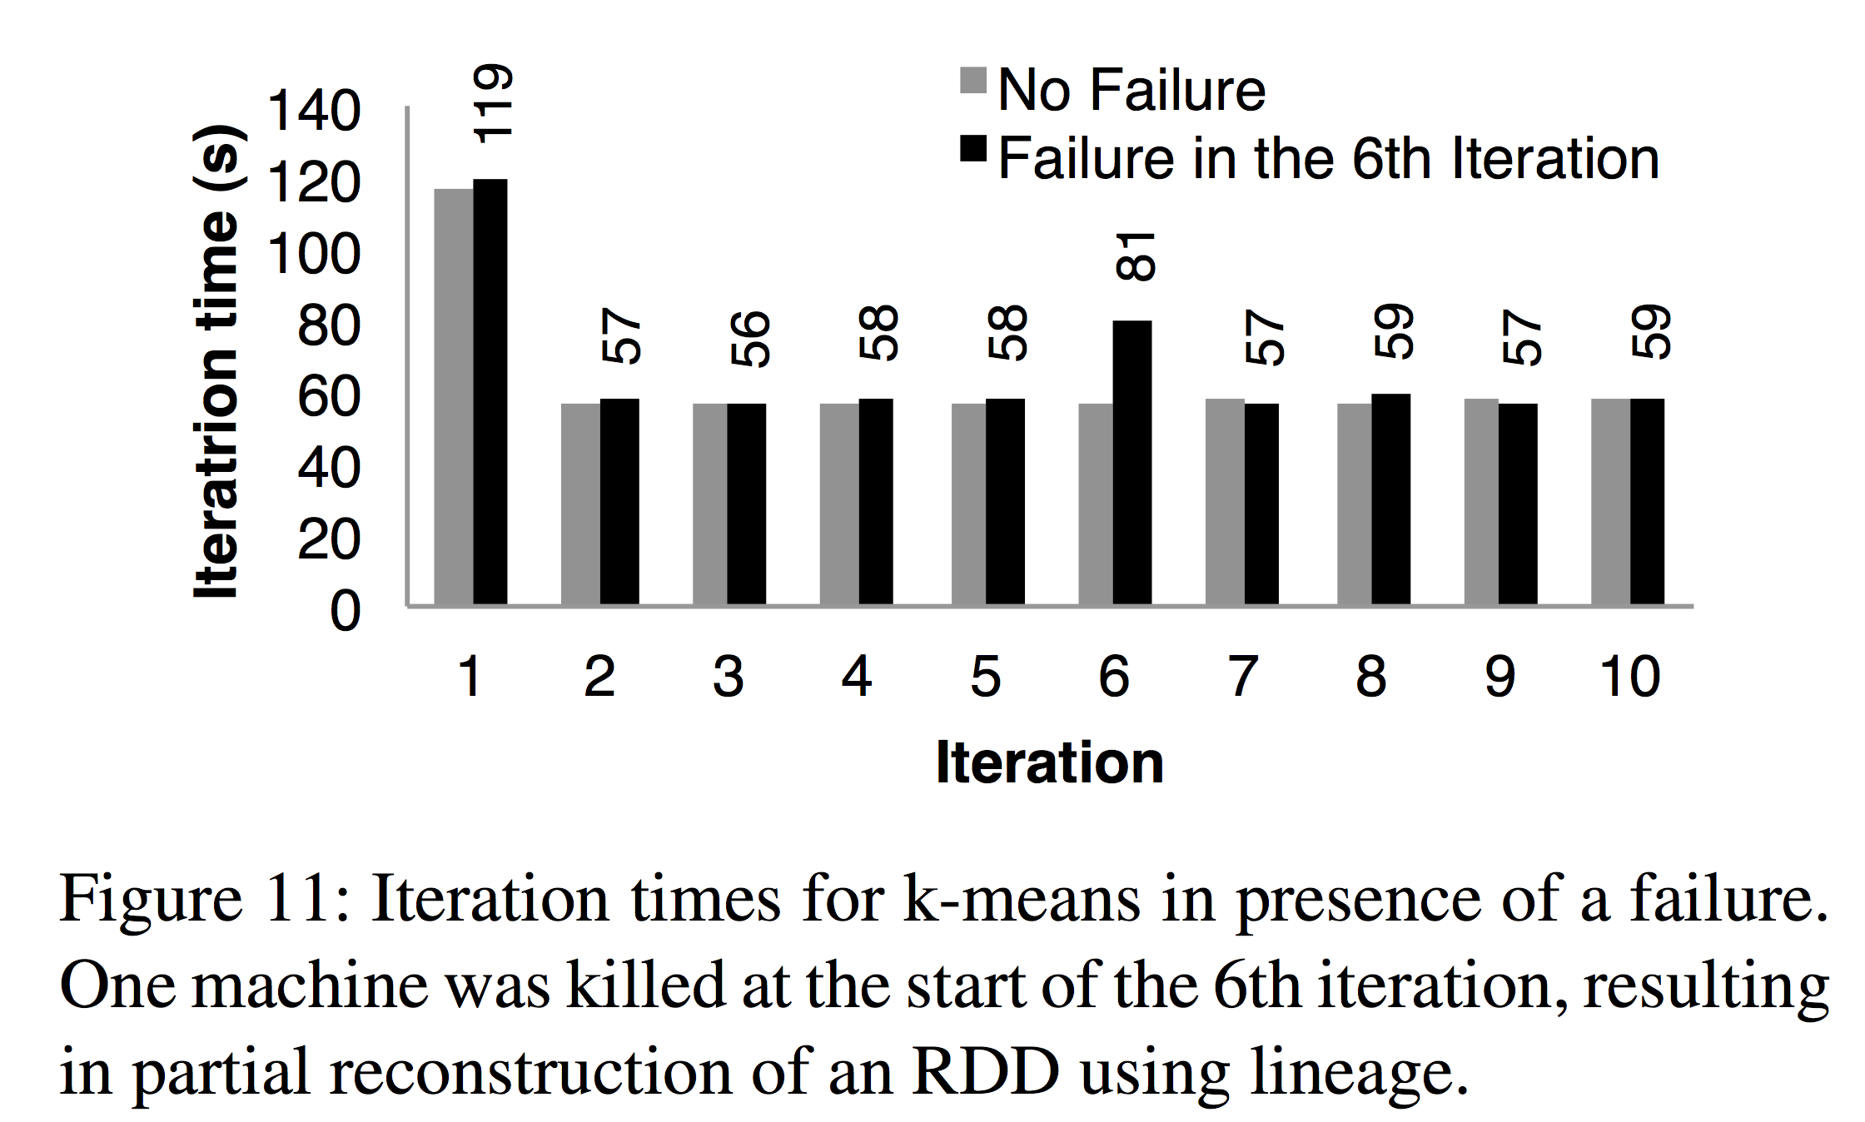
Evaluation : Fault Tolerance

Slide 28
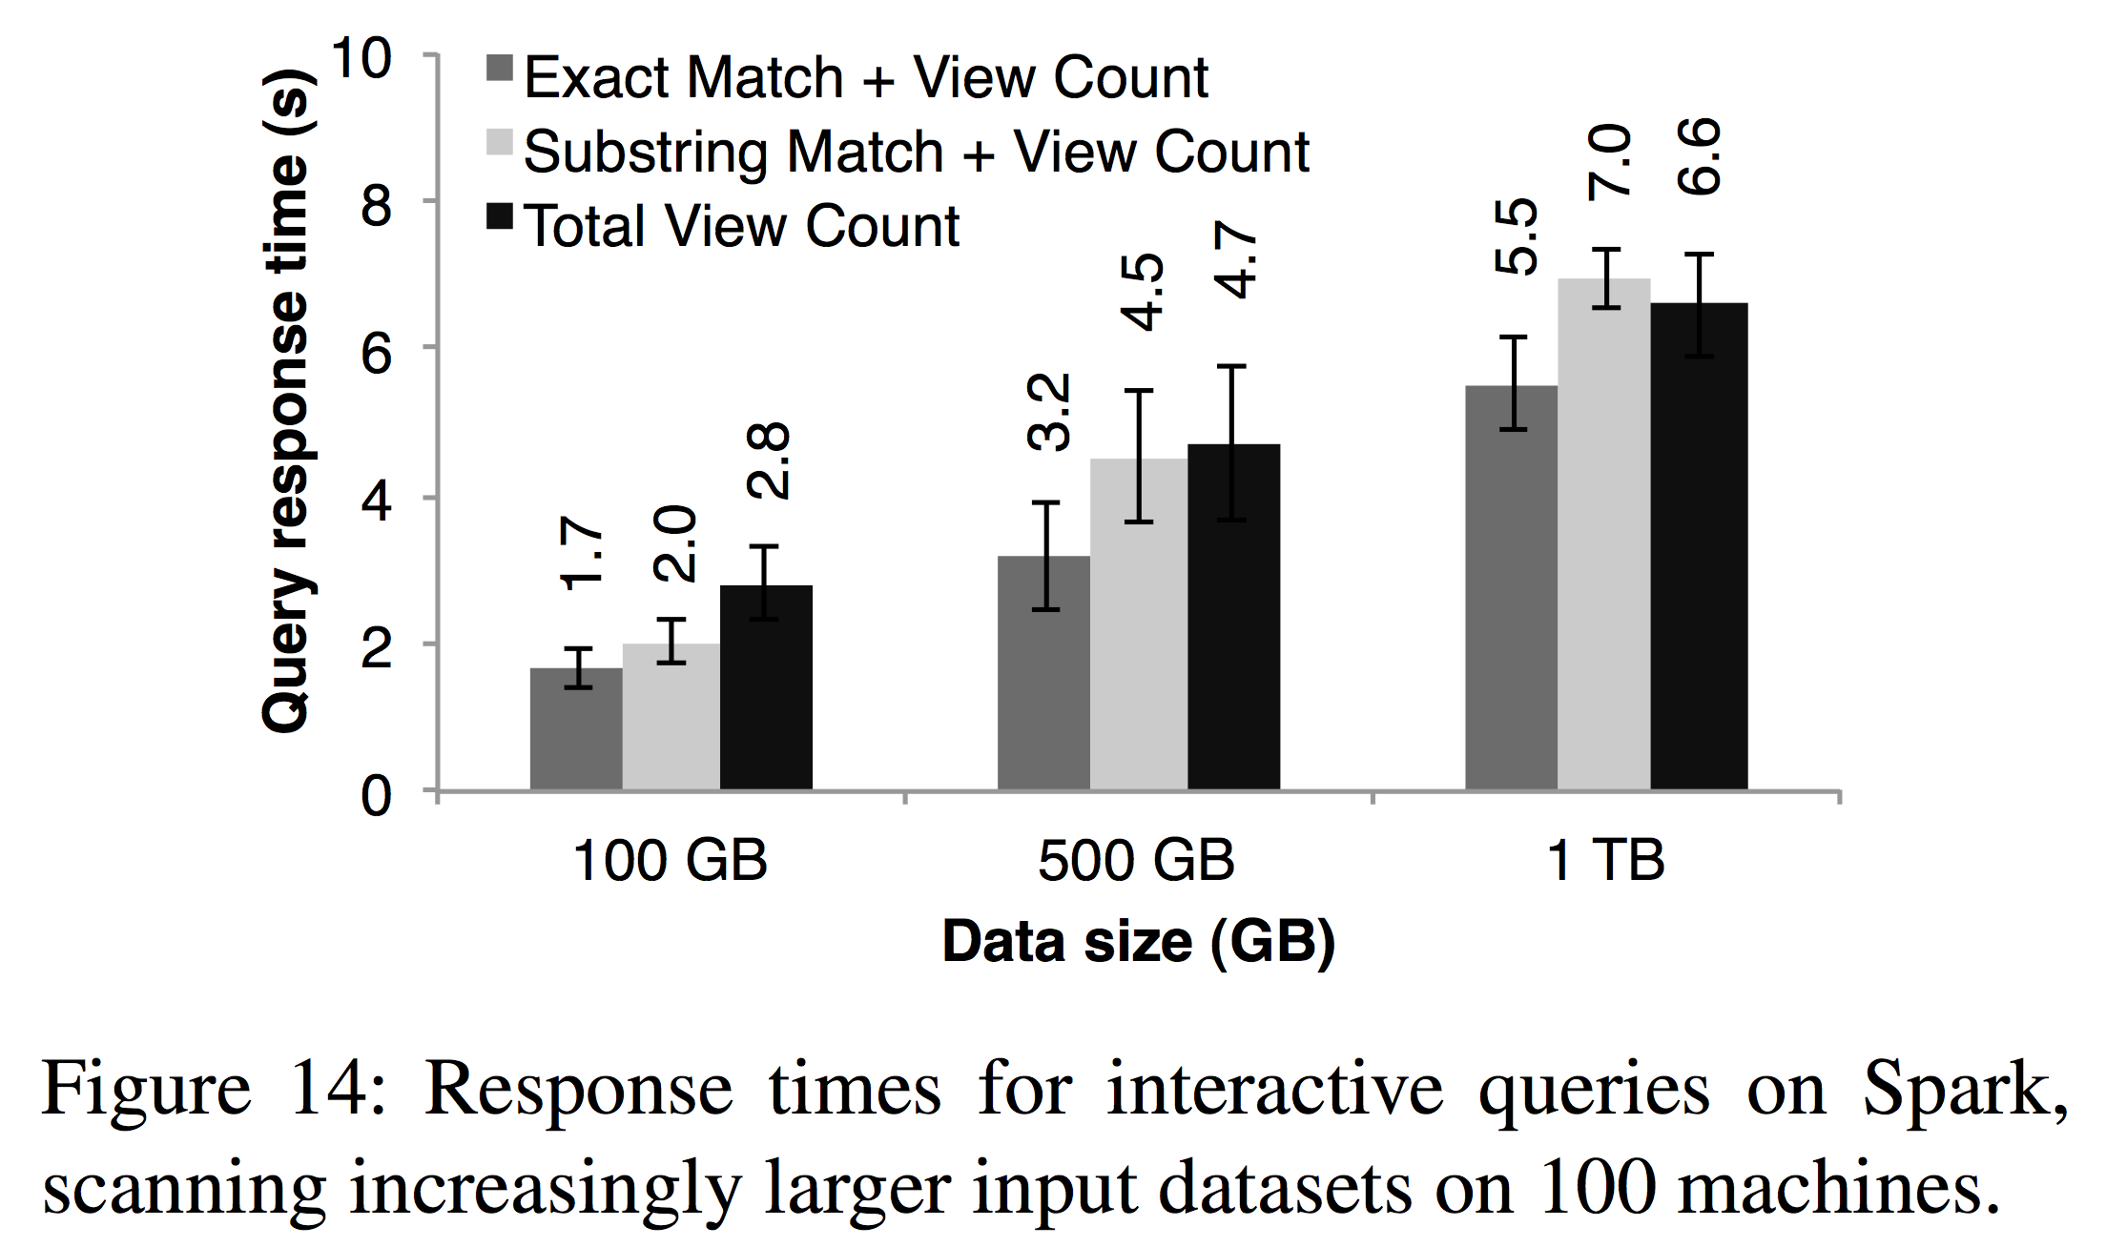
Evaluation : Interactive Queries

Slide 29
Thank you!!

